Slide 1

Heart Disease:
Factors that are attributed to heart disease will increase between the ages of 45-65.
Group 4: Kelly McDonald, Miranda Dahl, Ryan Freeman, Adolfo Linarez, Cameron Dumbauld, Albert Dudek

Slide 2
Hypothesis
Alternative Hypothesis:
The factors that are attributed to heart disease will increase between the ages of 45-65.
Null Hypothesis:
The factors that are attributed to heart disease will not increase between the ages of 45-65.
Notes:
Note: We are looking at factors that are commonly attributed to heart disease in regards to age, not these factors against heart disease itself.

Slide 3

Collecting and Cleaning Data
Dataset used: Heart Disease Data Set (https://archive.ics.uci.edu/ml/datasets/Heart+Disease)
Creators of Dataset:
1. Hungarian Institute of Cardiology. Budapest: Andras Janosi, M.D.
2. University Hospital, Zurich, Switzerland: William Steinbrunn, M.D.
3. University Hospital, Basel, Switzerland: Matthias Pfisterer, M.D.
4. V.A. Medical Center, Long Beach and Cleveland Clinic Foundation: Robert Detrano, M.D., Ph.D.
Kaggle.com
Heart Disease Dataset (https://www.kaggle.com/datasets/johnsmith88/heart-disease-dataset)
Heart Disease Prediction (https://www.kaggle.com/datasets/rishidamarla/heart-disease-prediction)
Multivariate dataset
Categorical, Integer, Real attributes
Number of Patients: 303 & 572
Number of Attributes 76: published experiments refer to a subset of 14 attributes

Slide 4
Collecting and Cleaning Data: Dataset #1
Age: In years
Sex: 0 = female; 1 = male
Cp: Chest pain (Value1: typical angina, Value2: atypical angina, Value3: non-anginal pain, Value4: asymptomatic)
Trestbps: Resting blood pressure (in mmHg)
Chol: Serum cholesterol (in mg/dl)
Fbs: Fasting blood sugar > 120 mg/dl (1 = true, 0 = false)
Restecg: Resting electrocardiographic results (values 0,1,2)
Thalach: Maximum heart rate achieved
Exang: Exercise induced angina (1 = yes, 0 = no)
Oldpeak: ST depression induced by exercise relative to rest.
Slope: The slope of the peak exercise ST segment. (Value 1: upsloping, Value 2: flat, Value 3: downsloping)
Ca: Number of major vessels (0-3) colored by fluoroscopy
Thal: Thalassemia is an inherited blood disorder caused when the body does not make enough hemoglobin. (3 = normal; 6 = fixed defect; 7 = reversible defect)
Target: Presence of Heart disease (0 = Absent, 1 = Present)
Notes:
1027

Slide 5
Collecting and Cleaning Data: Dataset #2
After cleaning and merging the data we focused on the following 9 attributes that were considered by both of the sources we pulled information from:
Age: in years
Sex: 0 = female; 1 = male
Chest pain type: Value1: typical angina, Value2: atypical angina, Value3: non-anginal pain, Value4: asymptomatic
BS: Resting blood pressure (in mmHg)
Cholesterol: Serum cholesterol (in mg/dl)
FBS over 120: Fasting blood sugar > 120 mg/dl (1 = true, 0 = false)
Exercise Angina: Exercise induced angina (1 = yes, 0 = no)
Number of blood vessel Fluro: Number of major vessels (0-3) colored by fluoroscopy
Heart Disease: 0 = Absent; 1 = Present
Notes:
207 samples

Slide 6
Subset of 9 attributes (Merged)
Age in years
Sex (0 = female, 1 = male)
Chest pain type (Value1: typical angina, Value2: atypical angina, Value3: non-anginal pain, Value4: asymptomatic)
BS (Blood Pressure) resting blood pressure (in mmHg)
Cholesterol (serum cholesterol in mg/dl)
FBS over 120 fasting blood sugar > 120 mg/dl (1 = true, 0 = false)
Exercise Angina exercise induced angina (1 = yes, 0 = no)
Number of blood vessel Fluro number of major vessels (0-3) colored by fluoroscopy
Heart Disease (0 = Absent, 1 = Present)
Notes:
After the merge, we have 572 rows

Slide 7
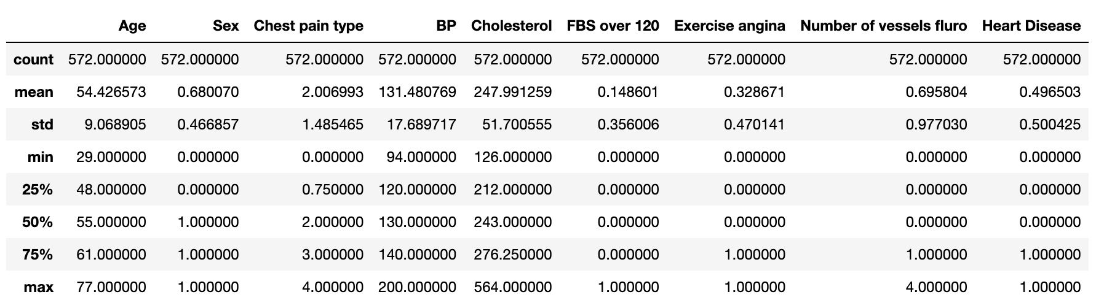
Statistics Summary

Slide 8
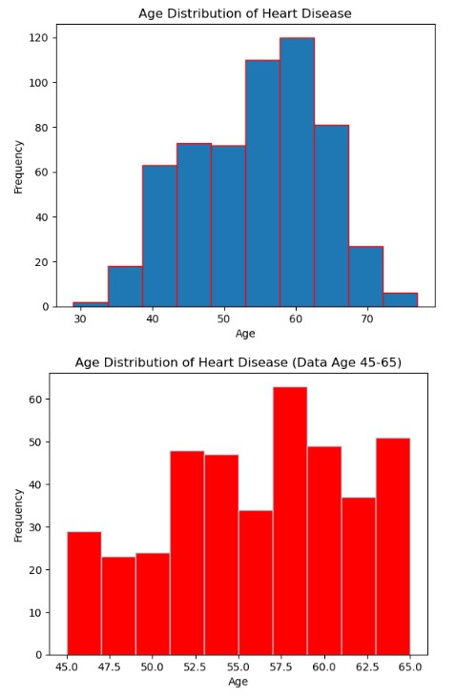
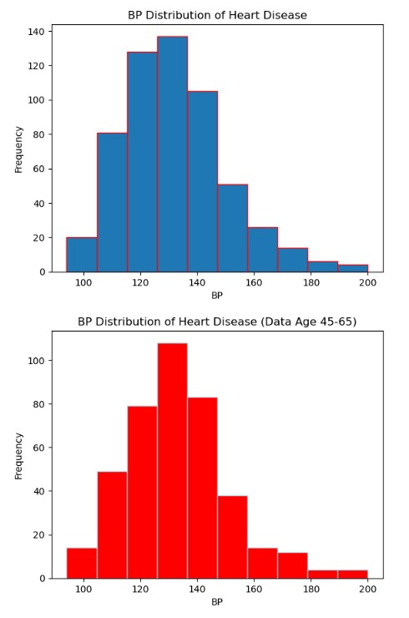
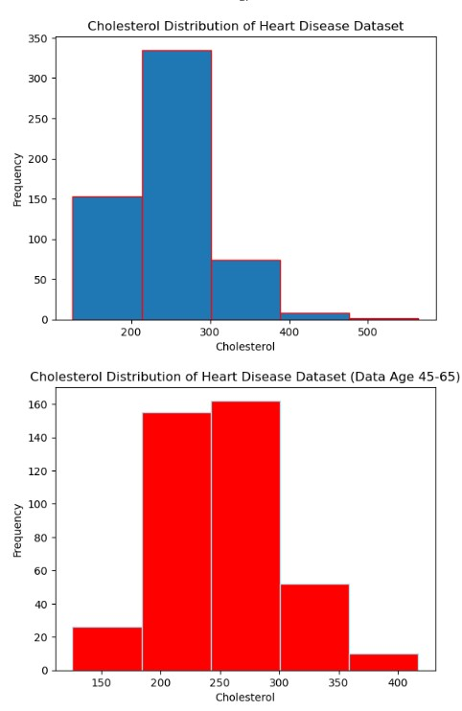
Notes:
Blood Pressure is normally distributed
Cholesterol is left-skewed
Number of vessels fluro is left skewed
Chest pain type is right-skewed

Slide 9
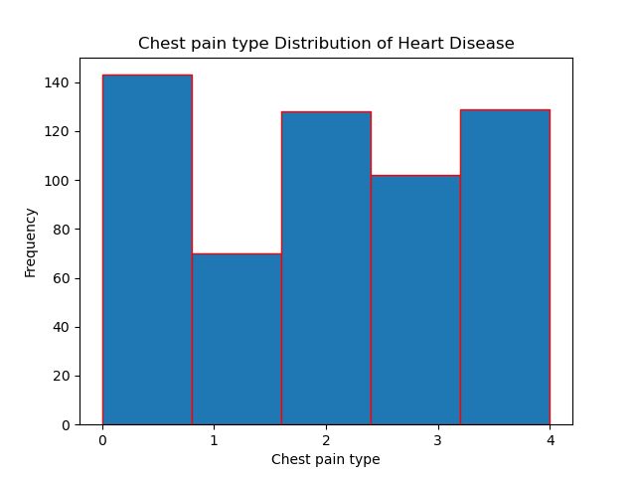
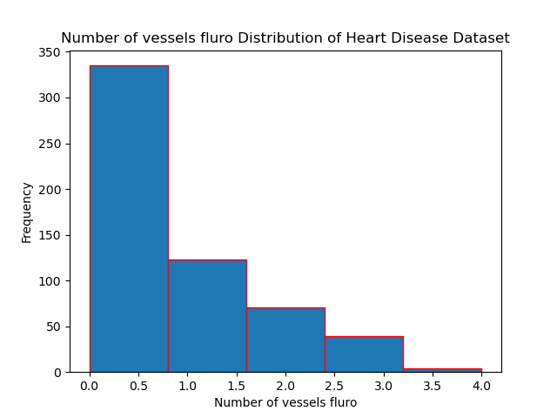
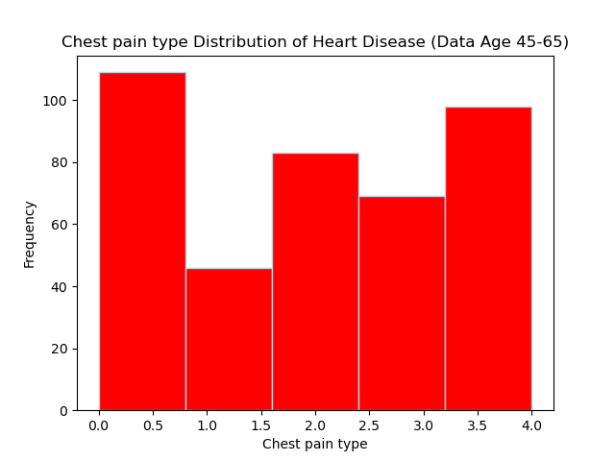
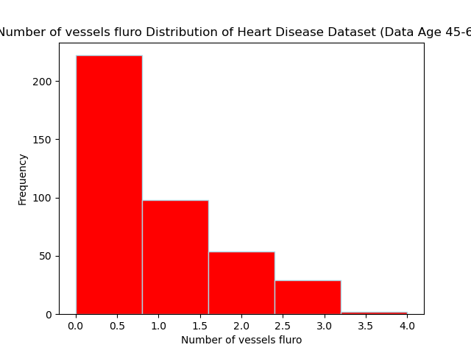

Slide 10
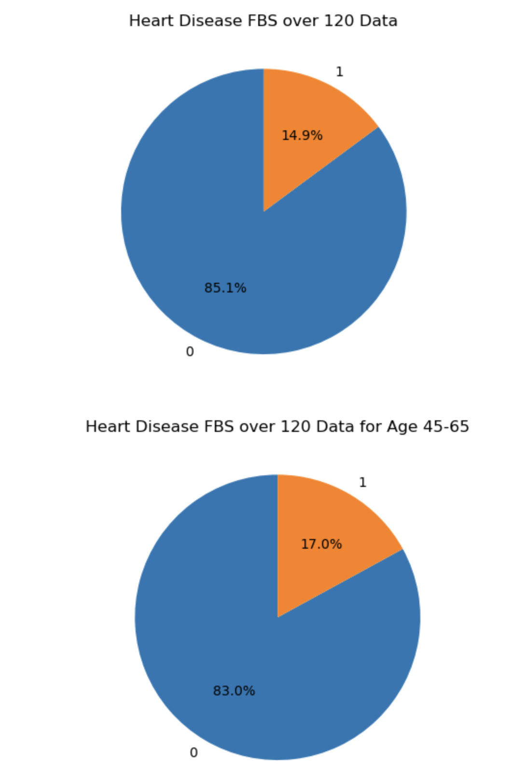
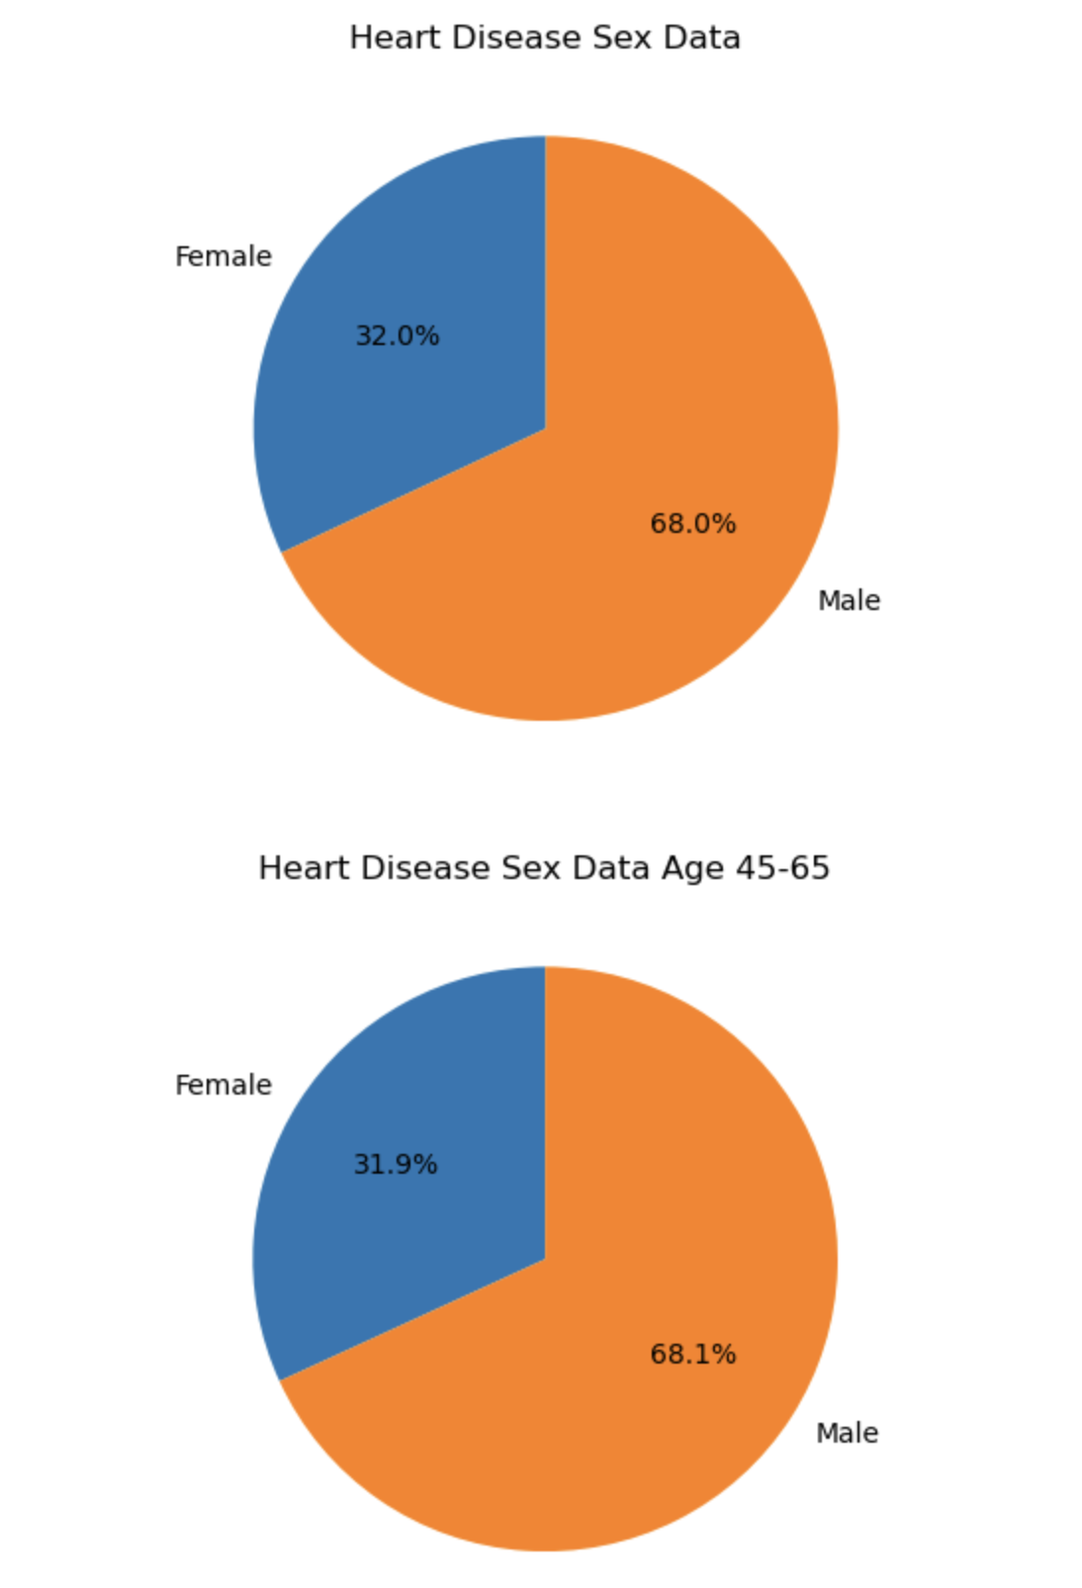

Slide 11
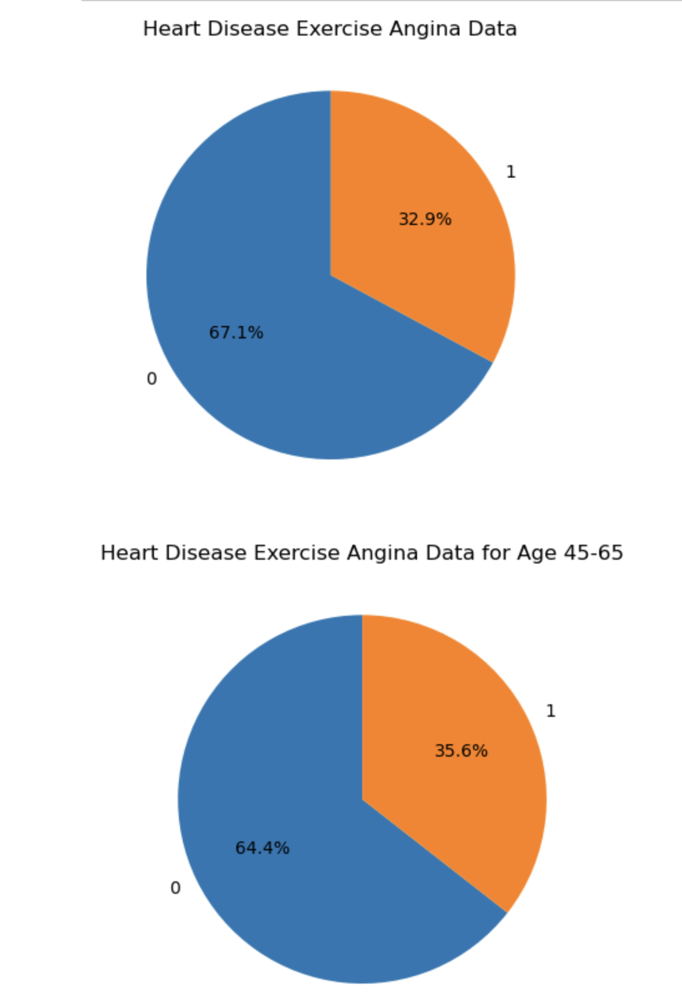
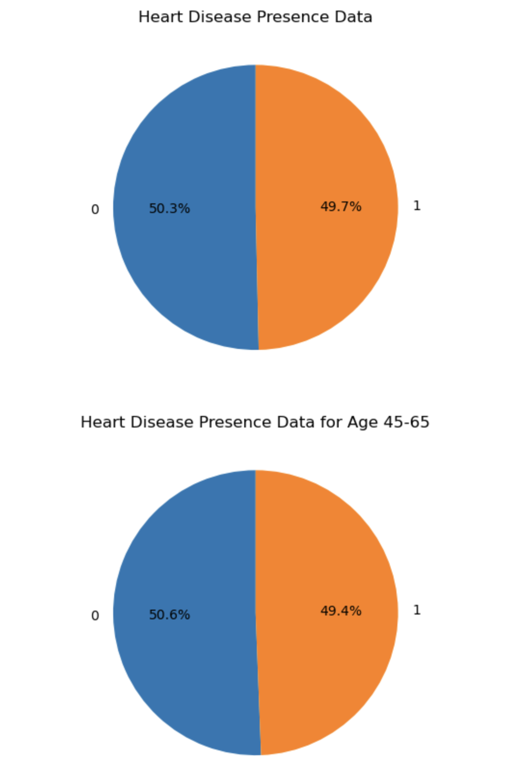

Slide 12
Pie Chart Analysis
Age vs Sex: The proportion of Sex remains fairly constant between both groups. There are more male than female patients in the dataset. 68% male to 32% female.
Age vs FBS over 120: There is a slight increase of FBS over 120 in the age group 45-65 years. The percentage of FBS over 120 increases from 14.9% to 17.0% for the age group 45-65 years.
Age vs Exercise Angina: There is a slight but noticeable increase of Exercise Angina in the age group 45-65 years. The percentage of the presence of Exercise Angina increased from 32.9% to 35.6% for the age group 45-65 years.
Age vs Heart Disease presence: There is no significant difference between the two groups. There is a slight decrease of the presence of Heart Disease in the age group 45-65 years of 49.4% versus 49.7% in the other age group (less than 45 and greater than 65 years).

Slide 13
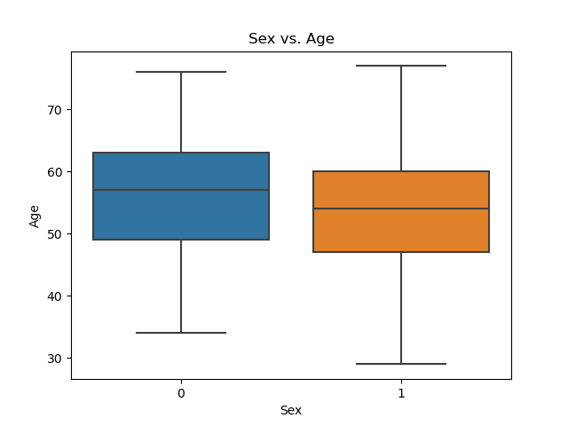
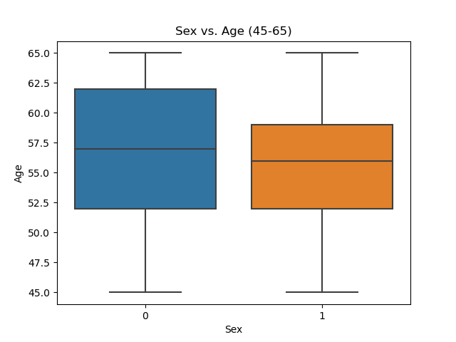
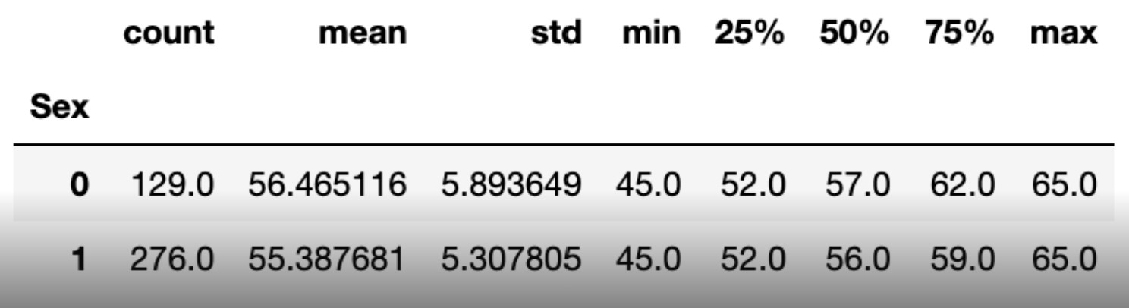

Slide 14
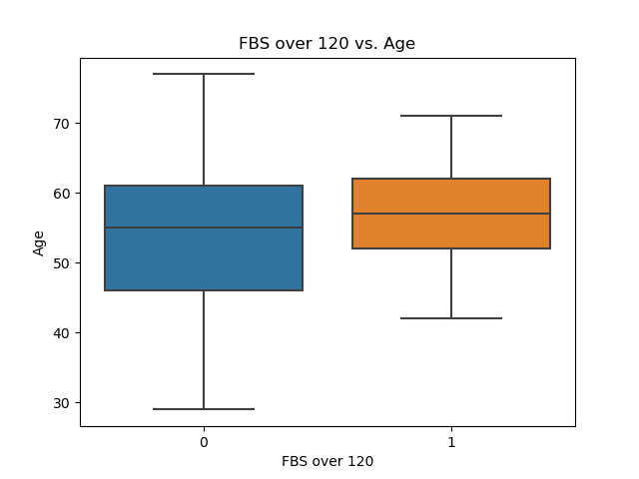
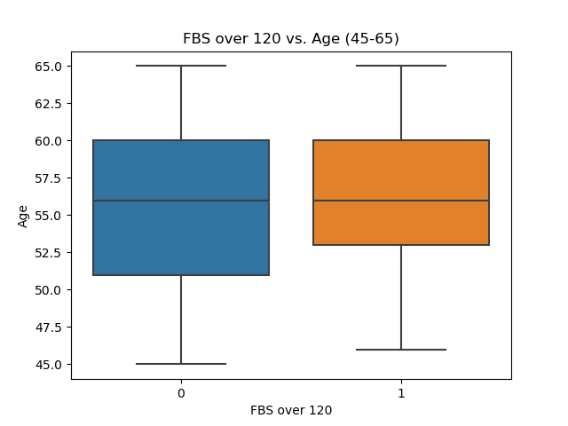
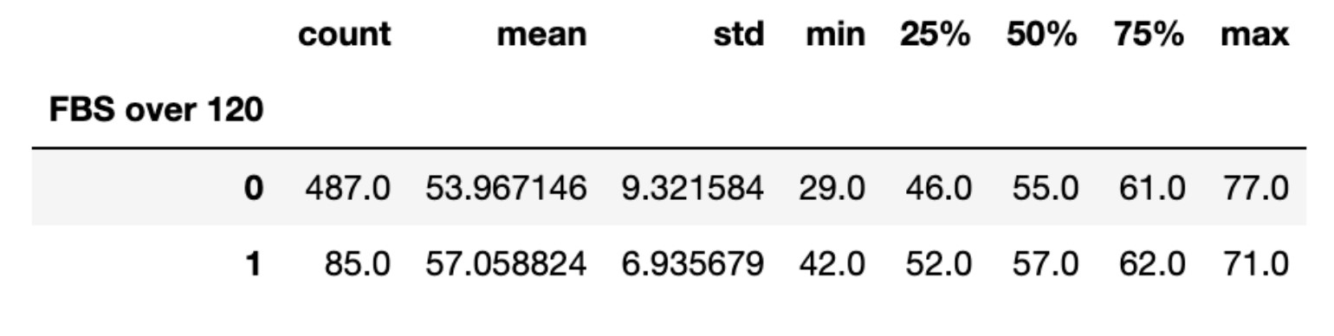
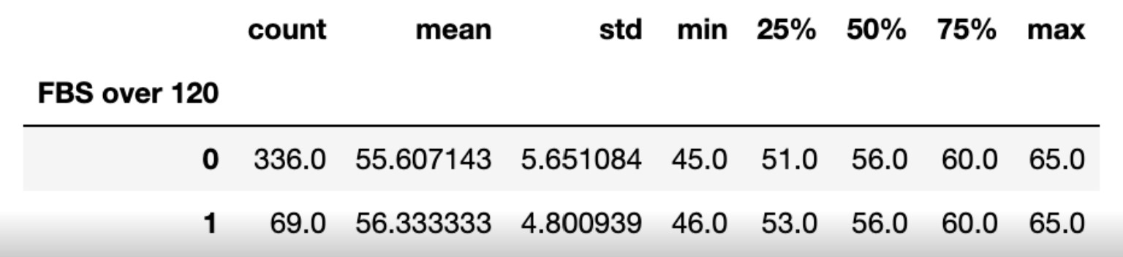

Slide 15
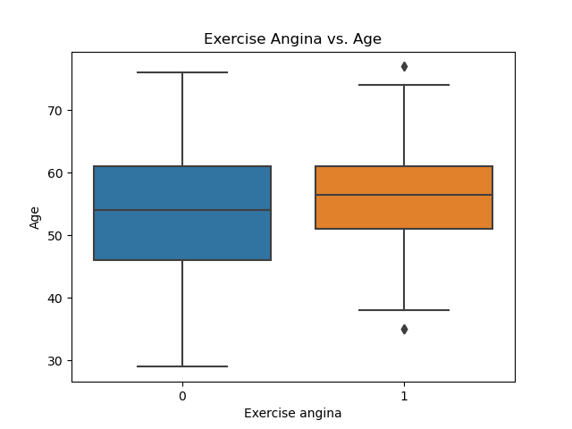

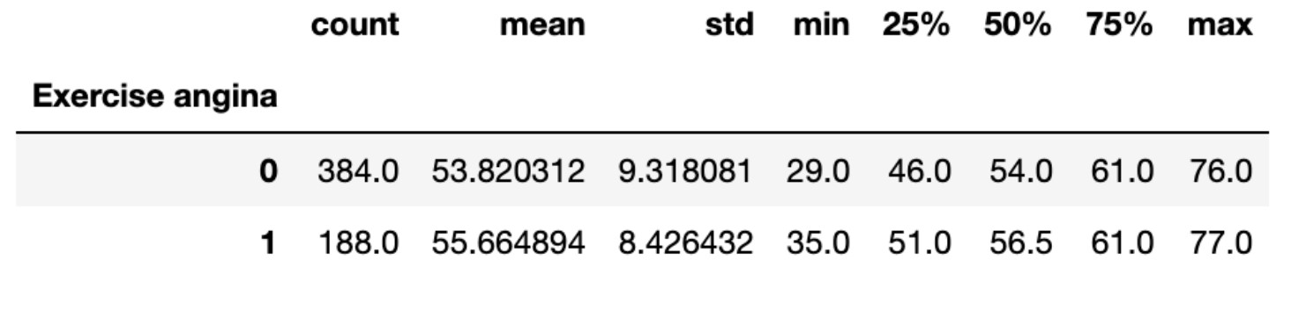
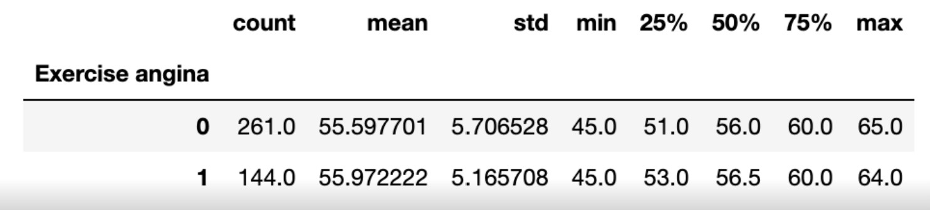

Slide 16
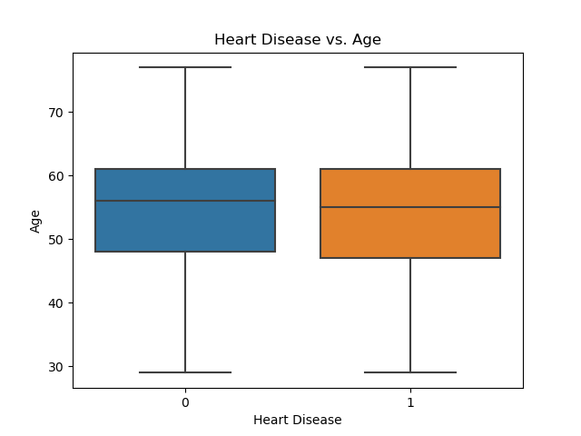
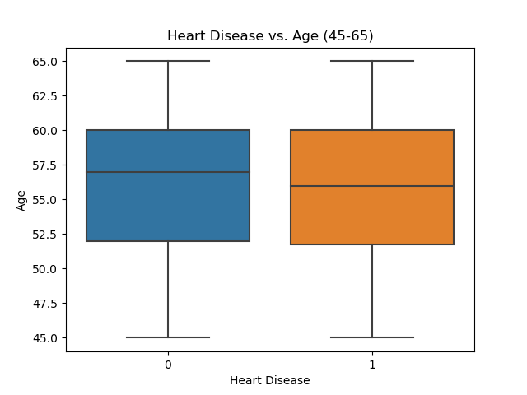
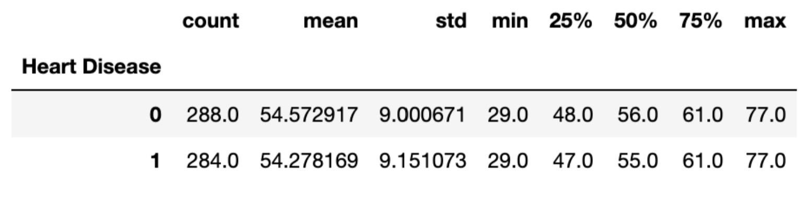
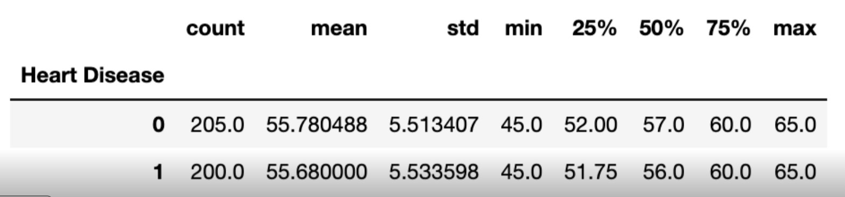

Slide 17
Box Plot Analysis
Age vs Sex: There is nearly a 2 to 1 ratio skewed to male patients. This dataset has more male patients than female patients. This is the case for both groups. The mean age for both groups is similar.
Age vs FBS over 120: FBS over 120 (orange boxes) occurs in a smaller range of ages compared to FBS under 120. It occurs at older ages starting at ~42 years. The mean age of the group with FBS over 120 is slightly older than the age group with FBS under 120.
Age vs Exercise Angina: There is an outlier in the group including all ages in the dataset. Similarly to FBS over 120, Exercise Angina generally occurs at older ages compared to the control population. The mean age of exercise angina (presence) is slightly older than the absence of exercise angina for the entire age group.
Age vs Heart Disease (absence or presence): The two groups almost mirror each other. However the mean age of both groups is slightly older in the absence of heart disease.

Slide 18
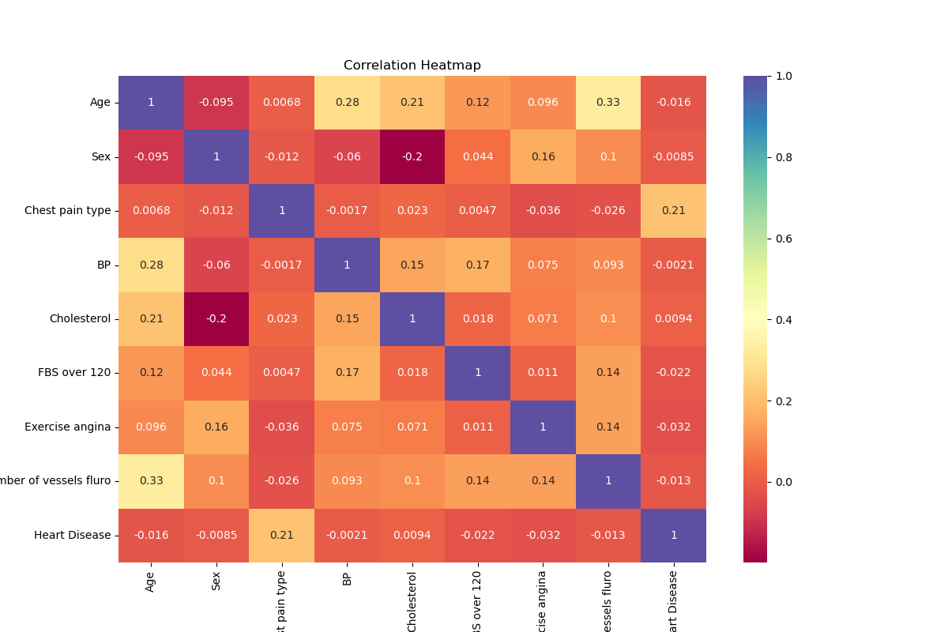
Correlation Heat Map (control group)
Significant factors:
Age has moderate positive correlation with number of vessels fluro (0.33).
Age has moderate-to-weak positive correlation with Blood Pressure (0.28).
Age has a weak positive correlation with Cholesterol (0.21).
Sex has a weak negative correlation with Cholesterol (-0.20). We choose Females to have value 0 and males to have value 1: there is a weak correlation that females are more likely to have higher cholesterol than males.

Slide 19
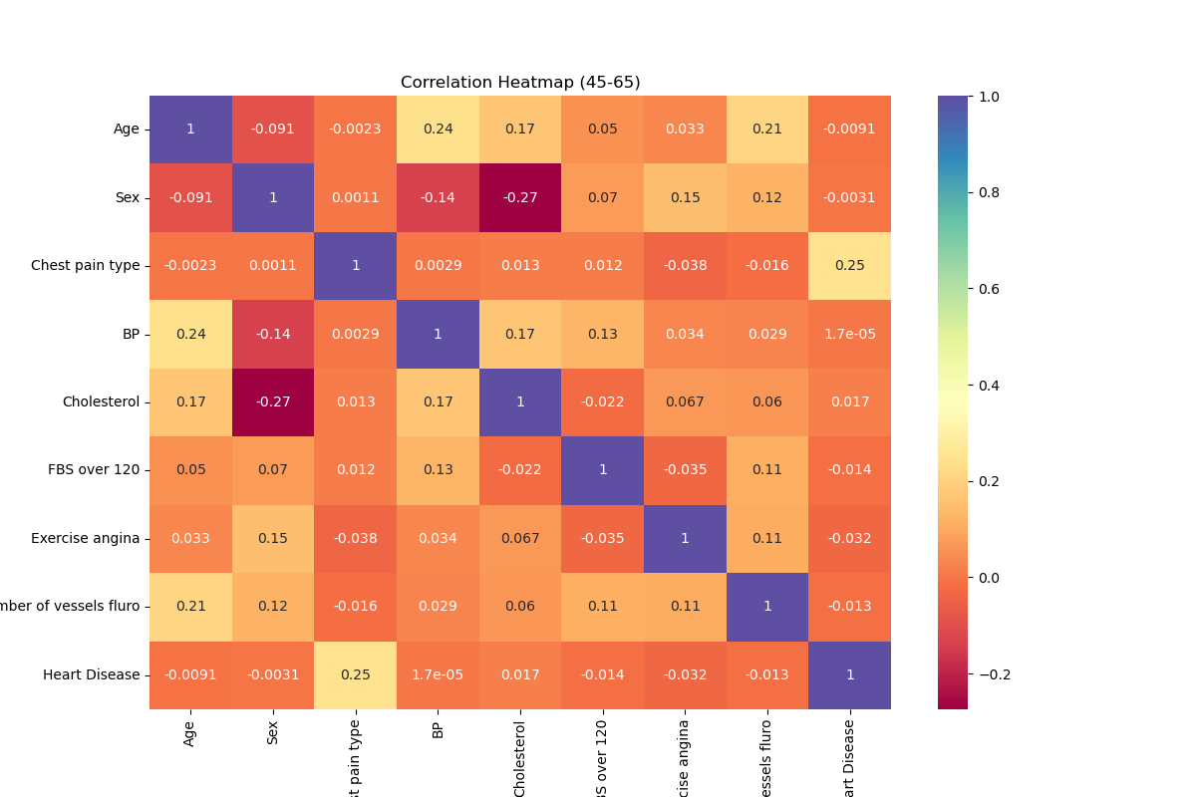
Correlation Heat Map (Age 45-65)
Significant factors:
Age has a weak positive correlation with Blood Pressure and Number of vessels fluro. (0.24 and 0.21, respectively)
Chest Pain type and Heart Disease presence has a weak positive correlation. (0.25)
Sex and Cholesterol has a weak-to-moderate negative correlation. Females are more likely to have higher cholesterol than males. (-0.27)

Slide 20
Results: T-Test Analysis on Heart Disease Factors vs Age
Methodology: Age groups were broken into two subsets.
Ages 45 - 65
Ages less than 45 and ages greater than 65
Resulting P-Value from T-tests
Heart Disease (presence) vs Age: p-value = 0.8423
Cholesterol vs Age: p-value = 0.0299
Blood Pressure vs Age: p-value = 0.0158
FBS (fasting blood sugar) over 120 mg/dL vs Age: p-value = 0.0226
Exercise Angina vs Age: p-value = 0.0330
Sex vs Age: p-value = 0.9104
Chest pain type (0-4) vs Age: p-value = 0.9098
Number of Vessels Fluro vs Age: p-value = 0.0707

Slide 21
Conclusion
After collecting and analyzing this dataset, we accept the alternative hypothesis and reject the null hypothesis that factors attributed to heart disease increase with ages 45-65.
Cholesterol, Blood Pressure, FBS (fasting blood sugar) and Exercise Angina had p-values less than 0.05 when tested against the two age groups.
Notes: there was not a clear relationship between the presence of heart disease and the different age groups which can partly be explained by stating the limitations of the dataset we used.

Slide 22
Data Limitations
The UC Irvine study used only the data from patients that were referred to the Cleveland Clinic Foundation. This would imply that the data used was from patients suspected to have heart disease. The study did not include the general population. If it had, it may have impacted the results.
The dataset did not take into consideration other heart disease risk factors such as family history, race, ethnicity, income, smoking, or alcohol consumption.
The dataset is from a study that was done in 1988. Medical advancements have increased physician’s knowledge of heart disease or the new tools for the diagnosis and treatment of this disease.

Slide 23
Moving Forward
Data that we would like to see moving forward
More data from people younger than 45 (specifically younger than 30)
More data from people older than 65
Heart attack count per person (how many total heart attacks an individual has had if they’ve had more than 1)
Better conclusions could be made if we looked at more data that focused on genetics

Slide 24
Any questions?

